Slide 1
Clean-sheet supersonic engine design and performance
Project 47
Lead investigators: Steven Barrett, Jayant Sabnis, Raymond Speth, Choon Tan
Students: Prashanth Prakash, Laurens Voet
Project manager: Laszlo Windhoffer, FAA
Oct 23, 2019
Washington D.C.
This research was funded by the U.S. Federal Aviation Administration Office of Environment and Energy through ASCENT, the FAA Center of Excellence for Alternative Jet Fuels and the Environment, project 47 through FAA Award Number 13-C-AJFE-MIT under the supervision of Laszlo Windhoffer. Any opinions, findings, conclusions or recommendations expressed in this material are those of the authors and do not necessarily reflect the views of the FAA.

Slide 2
Introduction
Increasing interest in civil supersonic transport in the private sector
50 years ago: The first test flight of the Concorde
  No measurable progress since then
Existing environmental regulations based on the Concorde (e.g. FAA 14 CFR Part 34, CFR Title 14 Part 36.301 Noise limits: Concorde)
Need to understand the environmental footprint of modern SSTs
  Leverage significant advances in modeling capabilities
Challenges posed by the SSTs:
Engine and aircraft operating conditions are significantly different
Propulsion systems built around existing engines or engine cores
No clean-sheet engine development programs due to high E&D cost
Notes:
FAA 14 CFR Part 34
CFR Title 14, Part 36.301 Noise limits: Concorde

Slide 3
Motivation
Flight speed and altitude for SSTs affect their thermodynamic cycle and the noise/emissions performance of the propulsion system
Combustor pressure and temperature will be different due to changes in ambient conditions as well as flight speed
Use of existing engine core may not preserve their emissions performance
Higher jet velocity necessary for high speed flight presents noise challenges
Use industry standard models for engine performance, combustion chemistry and noise assessment

Slide 4
Project description
RESEARCH QUESTION:
What are the noise and emissions characteristics of clean-sheet and derivative engines designed for future civil supersonic transport aircraft?
Identify operating requirements for propulsion system
Build engine cycle model to explore the design space
Quantify fuel burn, noise and emission characteristics
Compare clean-sheet design to a repurposed engine core

Slide 5
Objectives and expected outcomes
Understand the challenges of supersonic aircraft engine technology
  Repurposing an existing engine core versus a clean-sheet engine design
  Increased challenge of designing for both cruise (high specific thrust – high FPR) and take-off condition (low specific thrust – low FPR)
Develop a technological basis for environmental regulations of SST
  Supersonic regulations based on the Concorde
  Lack of sufficient understanding to set meaningful regulations
Identify what new technologies are needed to mitigate the environmental impact of supersonic aircraft engines
  Prioritize components and technologies needed
  Develop a research roadmap for engine architectures

Slide 6
Approach
Emission modeling
(Cantera)
Emission index for all emissions
Aircraft characteristics and mission profiles
Propulsion system requirements
Engine model
(NPSS)
Engine noise modeling
Engine noise contribution (EPNdB)

Slide 7
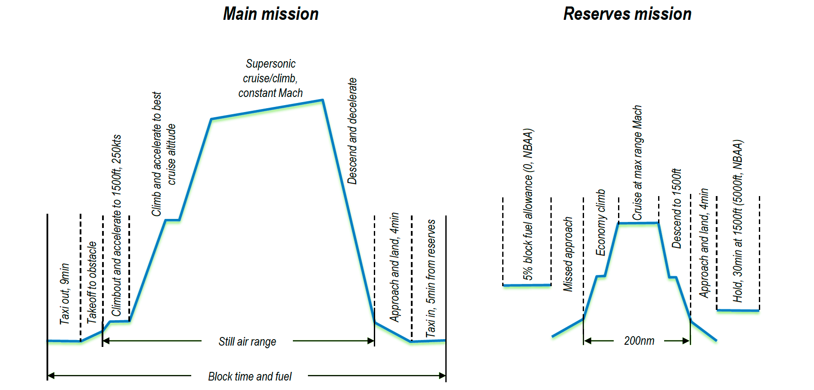
Mission analysis
Preliminary mission analysis using SUAVE (Stanford University Aero-Vehicle Environment) to define propulsion system requirements
Considering multiple aircraft (cruise flight Mach number and size)
Collaboration with ASCENT 10, NASA and others
(55-tonne STCA Mission Profile)

Slide 8
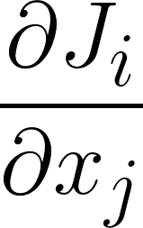
Engine modeling in NPSS
Modeling the derivative engine
(CFM56 as an example of a donor core)
Propulsion system
requirements from
mission analysis
Model the derivative core by modeling the CFM56-5B
Use the core developed to predict the performance of the CFM56-7B
Model the supersonic derivative engine by using the same core
Noise
Emissions
Fuel burn
Clean sheet engine design
sensitivities
Model clean-sheet engine thermodynamic cycle
Size the supersonic clean-sheet engine
Propulsion system
requirements from
mission analysis

Slide 9
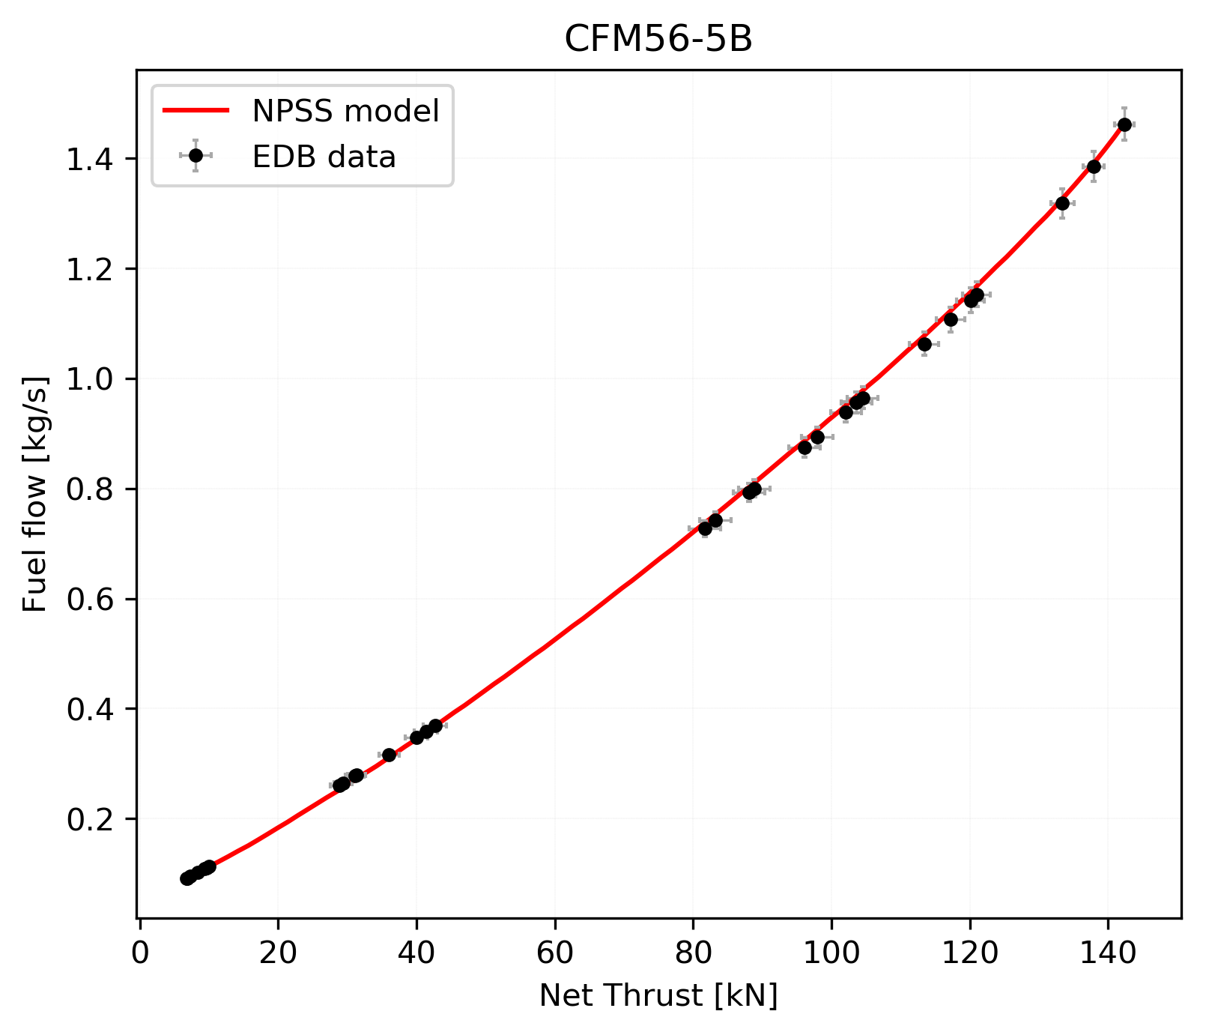
Modeling the CFM56-5B
Calibrate derivative core based on CFM56-5B “Tech Insertion” core
EDB data uncertainty*
Fuel flow: ±2%
Engine thrust**:
±1% at rated thrust
±5% at lowest setting
Calibration was successful as shown by the RMS percentage error ~ 2%
RMS error between NPSS model and EDB data = 2%
*Based on ICAO Annex 16, Vol 2, Attachment F to Appendix 3
**Linear variation between take-off power and minimum thrust used in test

Slide 10
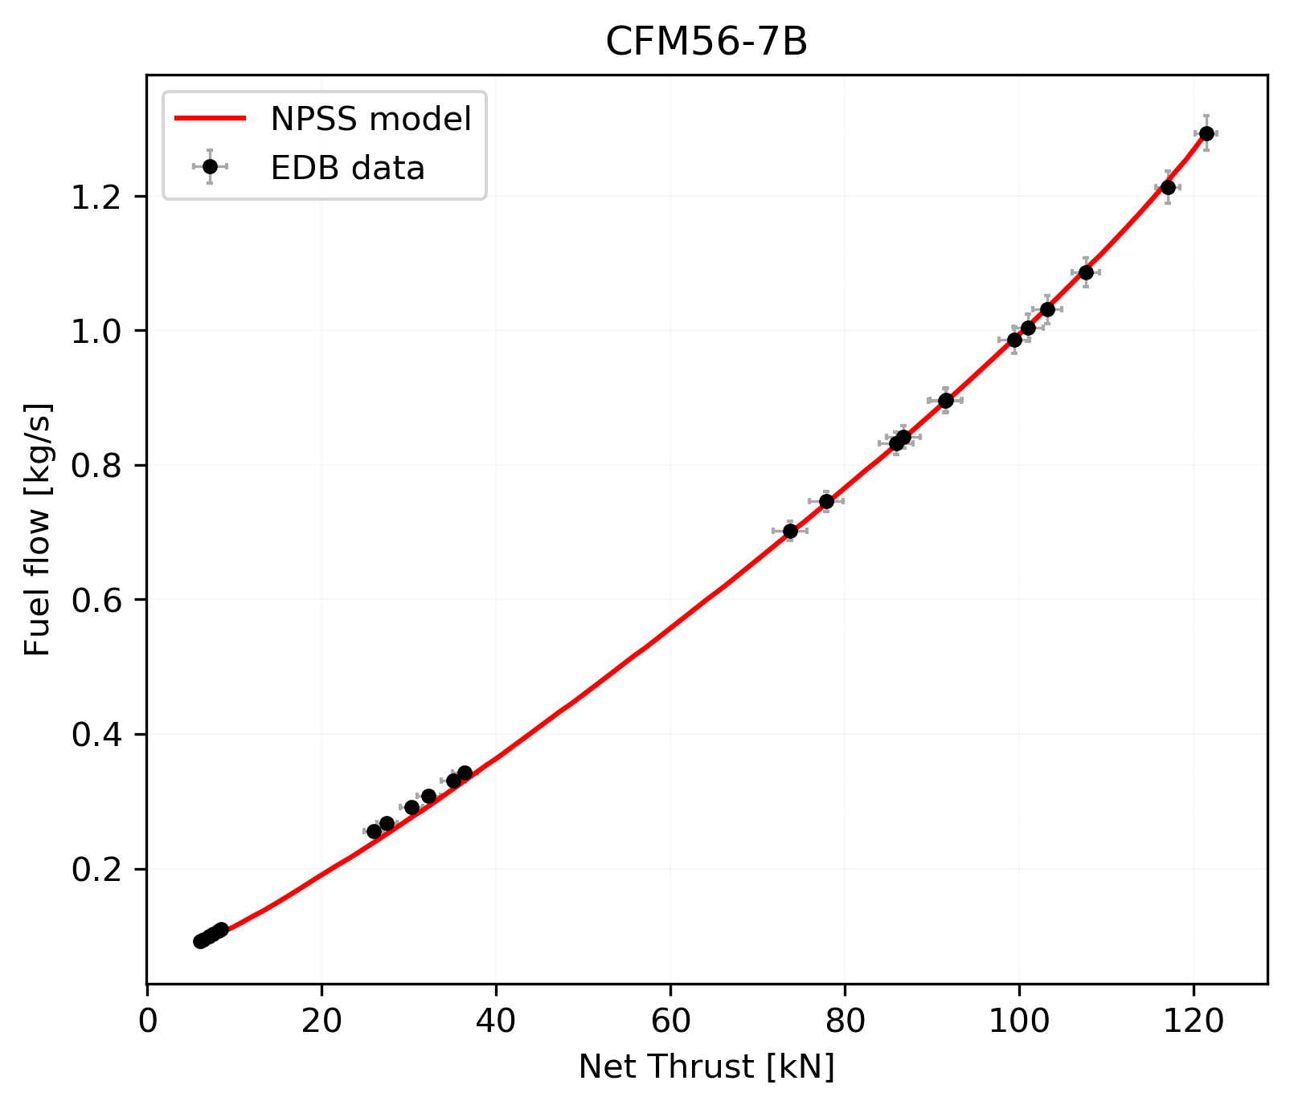
Using the common core in -7B
Test accuracy of core model via comparison with CFM56-7B engine
EDB data uncertainty*
Fuel flow: ±2%
Engine thrust**:
±1% at rated thrust
±5% at lowest setting
Match (RMS error ~ 3%) with CFM56-7B suggests good representation of the common core
RMS error between NPSS model and EDB data = 3%
*Based on ICAO Annex 16, Vol 2, Attachment F to Appendix 3
**Linear variation between take-off power and minimum thrust used in test
Notes:
Engine thrust uncertainty: measurement error

Slide 11
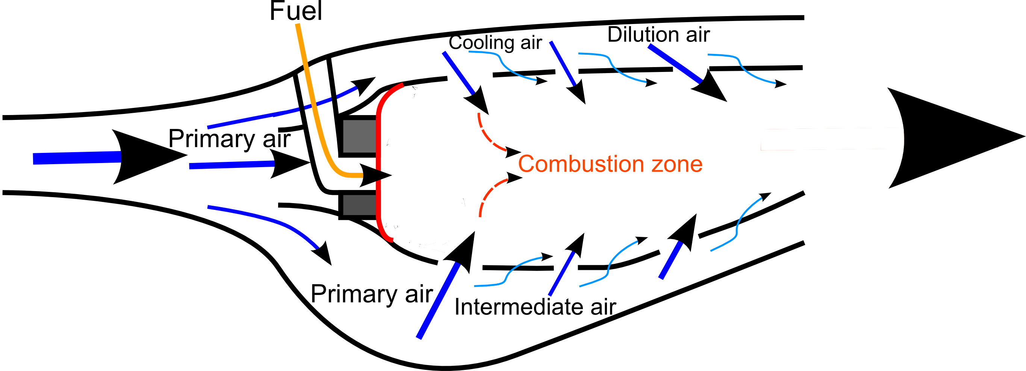
Combustor modeling using Cantera
Combustor emissions impacted by flow physics as well as chemistry
Combustor inlet conditions (temperature, pressure) and mass flow rates of fuel, primary, secondary and dilution air calculated using the NPSS engine model
Build a model of a gas turbine combustor that captures sufficient flow physics (primary zone mixing, secondary and dilution jets) to predict the NO_{x}, CO and soot emissions
Use Cantera to do thermodynamic and chemical kinetics calculations
Quantify NO_{x}, CO and soot at design point, LTO cycle and other off-design conditions

Slide 12
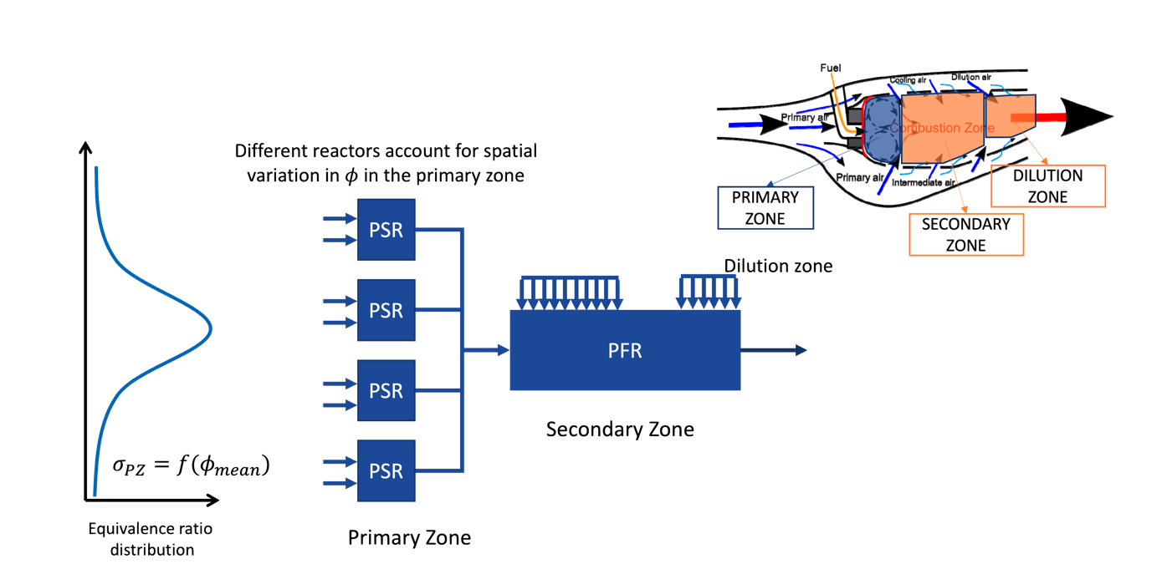
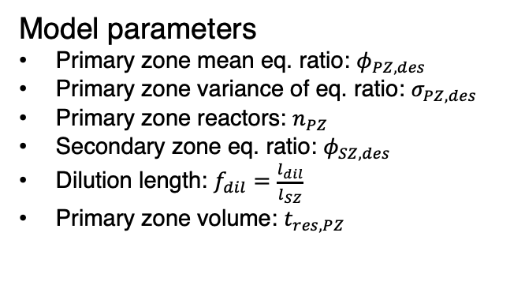
Approach for combustor modeling
Model parameters
Primary zone mean eq. ratio: $φ_{PZ,des}$
Primary zone variance of eq. ratio: $σ_{PZ,des}$
Primary zone reactors: $n_{PZ}$
Secondary zone eq. ratio: $φ_{SZ,des}$
Dilution length: $f_{dil}=\frac{l_{dil}}{l_{SZ}}$
Primary zone volume: $t_{res,PZ}$
PSR: Perfectly stirred reactor
PFR: Plug flow reactor

Slide 13
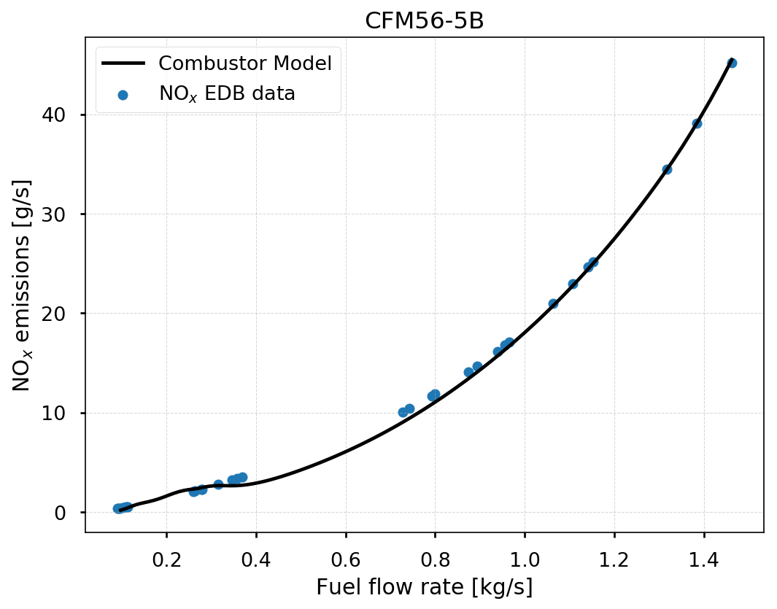
Reactor Network NO_{x} model
Calibrating combustor model to match CFM56-5B engine emissions
Additional work needed to better capture flow physics and other emissions
RMS error between Combustor model and EDB data = 20%

Slide 14
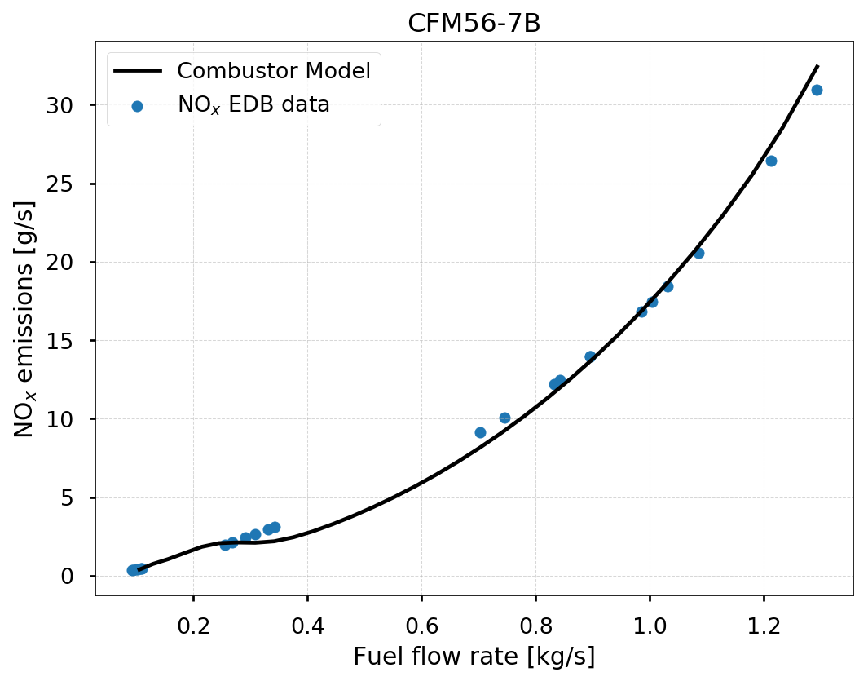
Predicting the NO_{x} emissions from CFM56-7B
Using calibrated combustor model, evaluate CFM56-7B emissions with NPSS model to provide T_{t3}, P_{t3} and mass flow rates
Additional work needed to better capture flow physics and other emissions
RMS error between Combustor model and EDB data = 21%

Slide 15
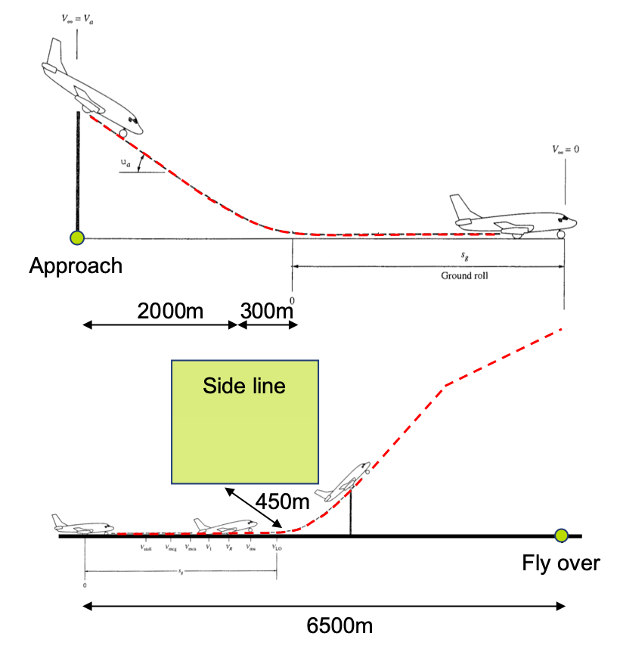





Approach for noise modeling
Engine model
Jet module
Sound pressure level
$$SPL$$
Fan module
Annoyance
(Perceived noise level)
$$PNL$$
Core module
Tone correction
(PNL with tone correction)
$$PNLT$$
…
Duration correction
(Effective PNL)
$$EPNL$$
$$EPNL$$
ICAO Annex 16:
Noise certification
Noise Sources
Effective Perceived Noise calculation

Slide 16
Noise modeling
Analysis phase:
Apply existing noise estimation methods to build source noise database
  Goal: SPL as function of frequency and directivity for individual noise source
  For example SAE ARP876 for jet noise
Use ICAO Annex 16 Noise certification framework to evaluate noise footprint
EPNL as driving parameter
Quantify noise footprint of derivative engine

Slide 17
Noise modeling
Design phase:
Identify main engine parameters that are driving noise footprint as function of frequency spectrum
  Develop roadmap for technology development on reducing noise footprint
Clean-sheet to reduce noise footprint
  Comparison with derivative engine

Slide 18
Summary
A first-principles based approach to provide rational basis for regulations and identifying new technologies to improve the environmental footprint
Modeled the CFM56-5B/7B engines, whose core will be used to model a derivative engine for an SST
Reactor network based gas turbine combustor model built to estimate NO_{x} emissions
Next steps:
  Extend combustor model to capture CO, HC and soot
  Build noise model to quantify engine noise
  Model derivative engine based on inputs from collaborators (mission and airframe)
  Model clean-sheet engine for given mission and airframe

Slide 19
Schedule
2019
2020
Activity
Sep
Oct
Nov
Dec
Jan
Feb
Mar
Apr
May
Jun
Tool development:
Combustor model development
Validation of combustor model
Noise tool development and validation
Mission requirements :
Continue mission analysis
to determine propulsion system requirements*
Derivative engine design:
Model core of legacy engines
Validate legacy engine models
Model derivative engine
based on mission requirements
Quantify sensitivities of emissions/
noise to engine design variables
Clean-sheet engine design:
Model clean-sheet engine
based on mission requirements
10/23/19
*seek inputs from NASA and A10 on propulsion system requirements

Slide 20
